Slide 1
History of Selenium
By Aravinda HB
Aru03.info@gmail.com
9945042504

Slide 2
History of Selenium
2014
WebDriver
Selenium Core
Selenium RC
Selenium Grid
Selenium 1
Selenium 2
Selenium 3
Release History
Selenium IDE
Why the name Selenium???

Slide 3

2004
In 2004 Jason huggins, an Engineer at Thoughtworks (Chicago) was working on a web application which required frequent Testing.
Manual Testing was becoming hard as it was time-consuming and inefficient.
He wrote a Javascript program that could interact with the browser and do actions
He called it as “JavaScriptTestRunner”

Slide 4
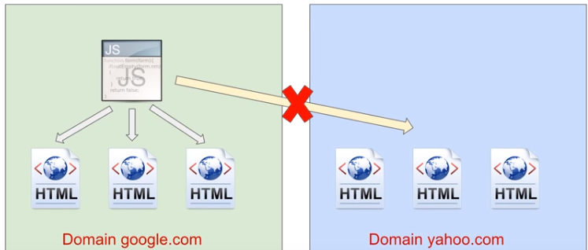
Same origin policy Issue
A web browser permits scripts contained in a first web page to access data in a second web page, but only if both web pages have the same origin.

Slide 5
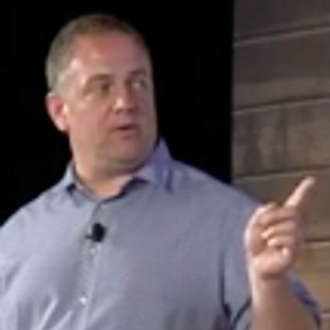
Selenium RC
After Jason Huggins started giving demo on “JavaScriptTestRunner”, Paul Hammant another Thoughtworks engineer started working to overcome the Same origin Policy .
He and his team added a server that acts as a http proxy to trick the browser to believe that selenium core and AUT come from the same domain and they named it as Selenium RC

Slide 6

Selenium IDE
Selenium was made open source and released to market in 2004
Selenium RC completely took over by selenium core and released to market in 2006 as Selenium-1
In 2006, Shinya Kasatani from japan understood the importance of Selenium core and created a FF Extension that has a capability of Record and Playback and named it as Selenium IDE.
He donated to selenium project in 2006
NOTE : Selenium IDE is a separate Project it is not a part of selenium main project

Slide 7

Selenium Webdriver
Simon Setwart an another Engineer working at Thoughtworks engineer started working on a project to create testing tool to overcome some limitations of selenium-1
He named
In selenium -1 we always require a server to inject with the web browser whereas in webdriver every browser will have its own driver and with the help of api all the information was exchanged so no need of separate server.
In 2011, selenium1 and webdriver were merged and named as Selenium2.0.

Slide 8

Selenium Grid
In 2007, Philippe Hanrigou, Started working on a server tool to enable parallel Execution of selenium Tests across multiple machines and named it as Selenium Grid.
Selenium Grid is just an extension to RC which enables running tests on multiple server in parallel(to save time and cost)
Grid released in 2007

Slide 9
Selenium 2.0/3.0
In 2011 Selenium 2.0 was introduced which is a combination of Selenium1 and WebDriver.
In 2016 Selenium 3.0, core selenium is deprecated and dropped i.e., all RC Components are replaced with webdriver compatible components

Slide 10


Selenium Releases
 | Core | WebDriver | W3C Webdriver
1.0 2006
2.0 2011
3.0 2016
4.0
5.0

Slide 11
2004
2006
2007
2007
2011
Jason Huggins Created a Selenium core @Thoughtworks
Paul Hammant and Pat Lightbody Created Selenium RC over the core to extend its capabalities.
Shinya Kasatani Created Selenium IDE
From 2006, Selenium RC completely took over selenium Core.
Simon Setwart Creates webdriver
Jason Huggins Joins Google
Philippe Hanrigou created Selenium Grid
Released in 2007
WebDriver merged with Selenium 1 to form Selemiun 2.0

Slide 12
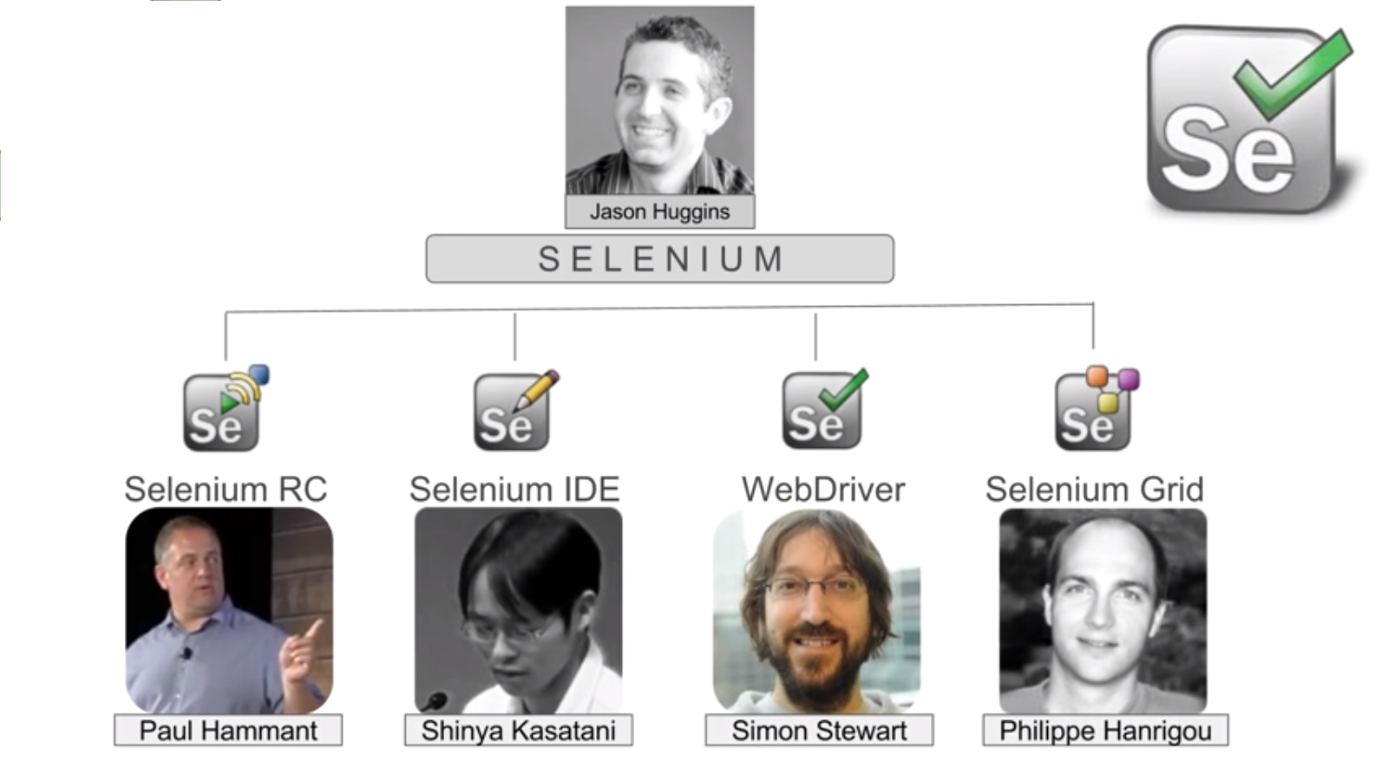

Slide 13





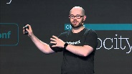
Jason Huggins Created a Selenium core @Thoughtworks
Paul Hammant and Pat Lightbody Created Selenium RC over the core to extend its capabalities.
Shinya Kasatani Created Selenium IDE
From 2006, Selenium RC completely took over selenium Core.
Simon Setwart Creates webdriver
Jason Huggins Joins Google
Philippe Hanrigou created Selenium Grid
Released in 2007
WebDriver merged with Selenium 1 to form Selemiun 2.0
Selenium 3.0 released and Selenium RC become redundant
2004
2006
2007
2007
2011
2016

